Slide 1
DIGESTIVE
SYSTEM
Al-Farabi Kazakh National University
Higher School of Medicine

Slide 2
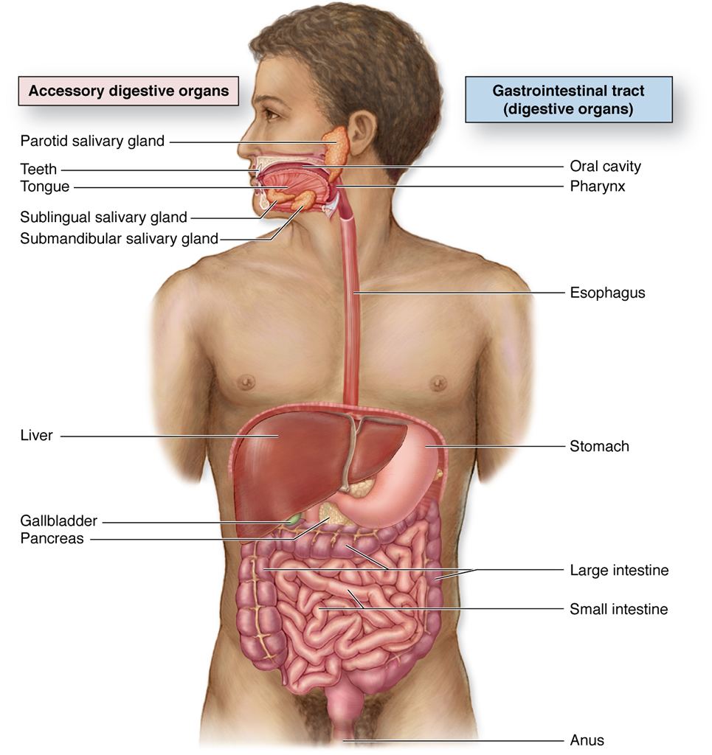

Slide 3
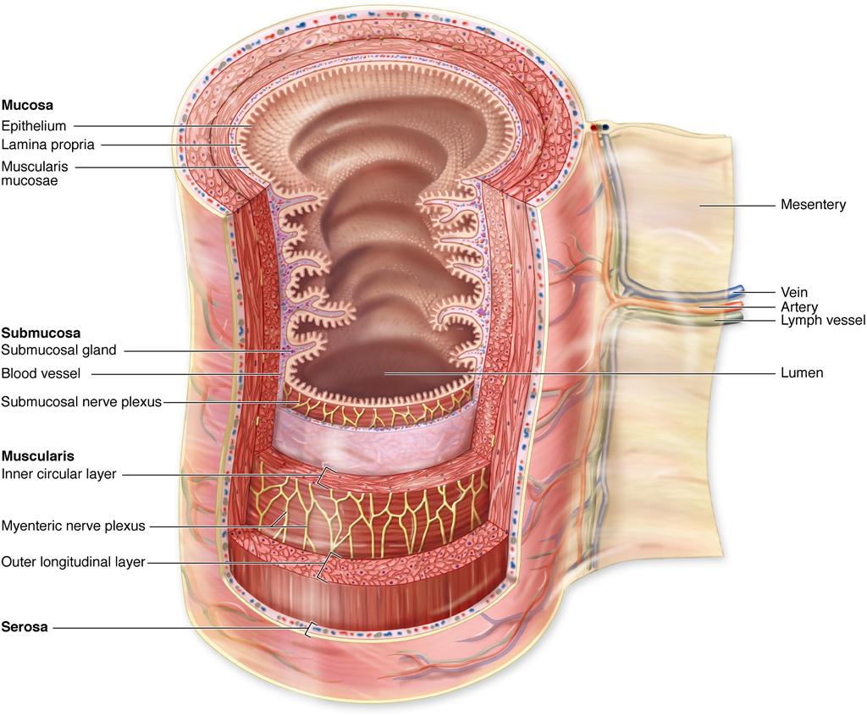

Slide 4
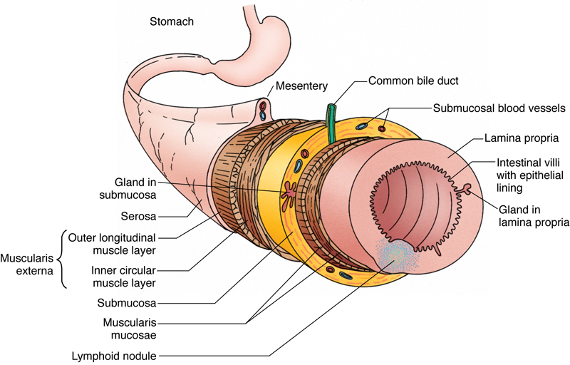
Alimentary Canal Overview
The histology of the alimentary canal often is discussed in terms of four broad layers: the mucosa, submucosa, muscularis externa, and serosa (or adventitia). These layers are similar throughout the length of the digestive tract but display regional modifications and specializations.
The lumen of the alimentary canal is lined by an epithelium, deep to which is a loose connective tissue known as the lamina propria. This richly vascularized connective tissue houses glands as well as lymph vessels and occasional lymphoid nodules. Surrounding this connective tissue coat is the muscularis mucosae, composed of an inner circular layer and an outer longitudinal layer of smooth muscle. The epithelium, lamina propria, and muscularis mucosae are collectively called the mucosa.
The mucosa is surrounded by a dense, irregular fibroelastic connective tissue layer, the submucosa. The submucosa has no glands except in the esophagus and duodenum; it houses blood and lymph vessels and Meissner’s submucosal plexus.
The submucosa is invested by a thick muscular layer, the muscularis externa, responsible for peristaltic activity, which moves the contents of the lumen along the tract.
The muscularis externa is enveloped by a thin connective tissue layer that may or may not be surrounded by the simple squamous epithelium of the visceral peritoneum. If the region of the alimentary canal is intraperitoneal, it is invested by peritoneum, and the covering is known as the serosa. If the organ is retroperitoneal, it adheres to the body wall by its adventitia.
For more information see General Plan of the Digestive Tract in Chapter 17 of Gartner and Hiatt: Color Textbook of Histology, 3rd ed. Philadelphia, W.B. Saunders, 2007.
Figure 17–1 Alimentary tract. Layer contents are generalized.

Slide 5
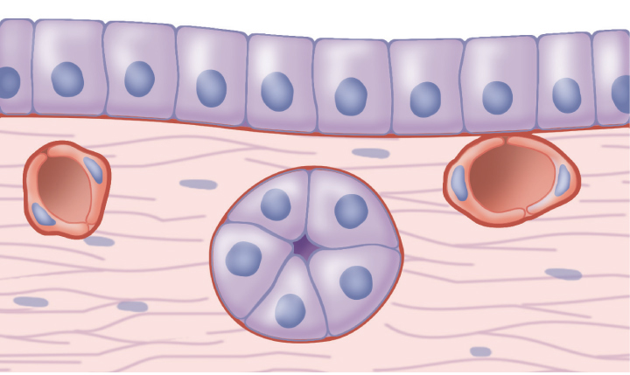

Slide 6
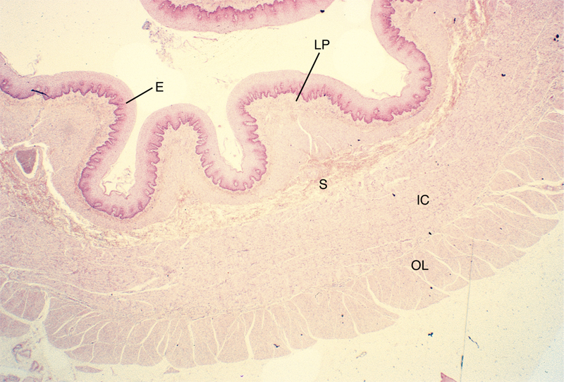
Esophagus
The lumen of the esophagus, lined by a thick, stratified squamous nonkeratinized epithelium.
The lamina propria houses esophageal cardiac glands, which produce a mucoid secretion.
The muscularis mucosae is unusual in that it consists of only a single layer of longitudinally oriented smooth muscle fibers.
The submucosa of the esophagus is composed of a dense, fibroelastic connective tissue, which houses the esophageal glands proper. These tubuloacinar glands produce a mucous secretion. Meisner’s submucosal plexus is present in the submucosa.
The muscularis externa of the esophagus is arranged in two layers, inner circular and outer longitudinal. However, these muscle layers are unusual in that they are composed of both skeletal and smooth muscle fibers. The muscularis externa of the upper third of the esophagus has mostly skeletal muscle; the middle third has both skeletal and smooth muscle; and the lowest third has only smooth muscle fibers. Auerbach’s plexus occupies its usual position between the inner circular and outer longitudinal smooth muscle layers of the muscularis externa.
The esophagus is covered by an adventitia until it pierces the diaphragm, after which it is covered by a serosa.
For more information see Esophagus in Chapter 17 of Gartner and Hiatt: Color Textbook of Histology, 3rd ed. Philadelphia, W.B. Saunders, 2007.
Figure 17-2 Light micrograph of the esophagus (´17). Note that the lumen is lined by a relatively thick stratified squamous epithelium (E) that forms a well-developed rete apparatus with the underlying lamina propria (LP). The submucosa (S) is surrounded by a thick muscularis externa, composed of inner circular (IC) and outer longitudinal (OL) muscle layers.

Slide 8
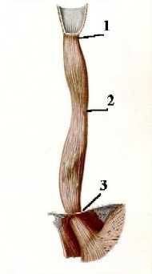
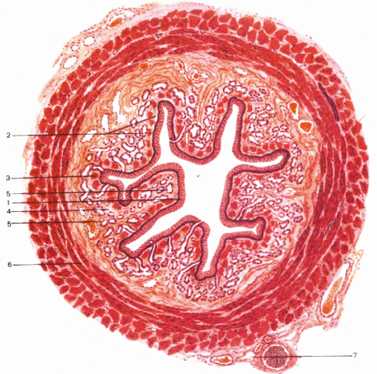

Slide 9
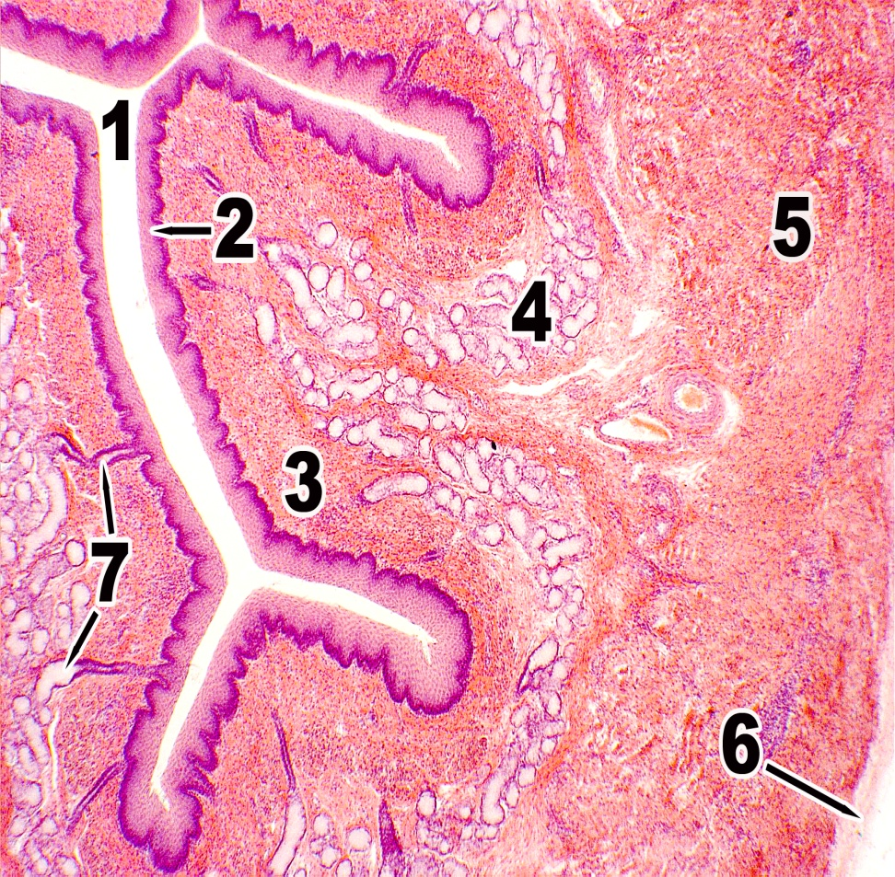

Slide 10
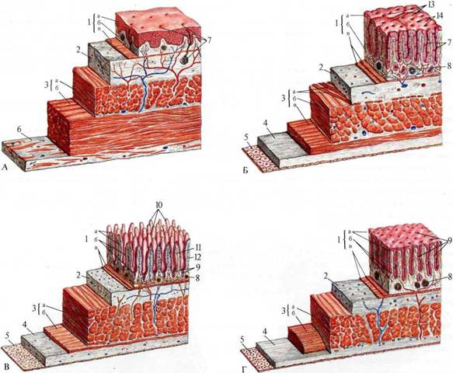

Slide 11
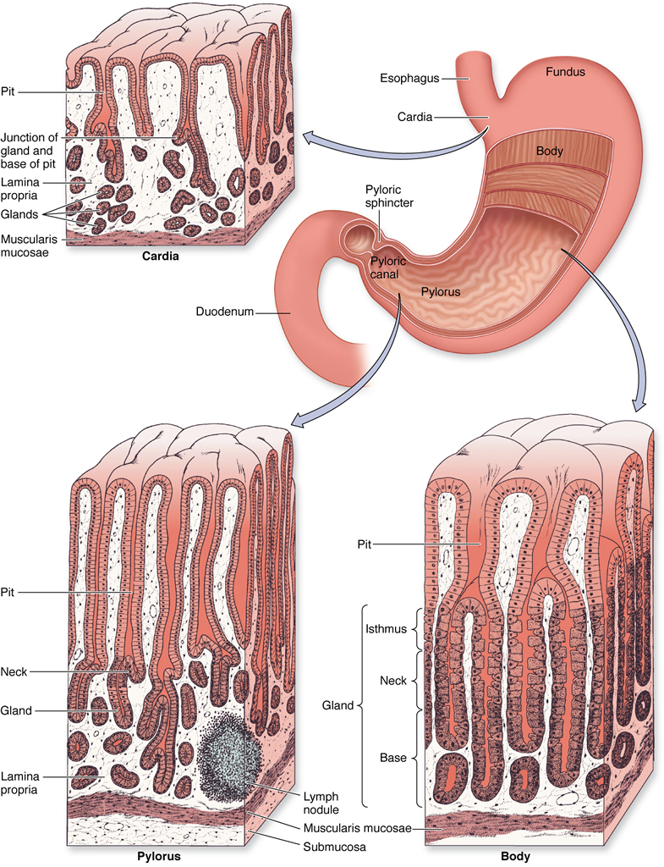

Slide 12
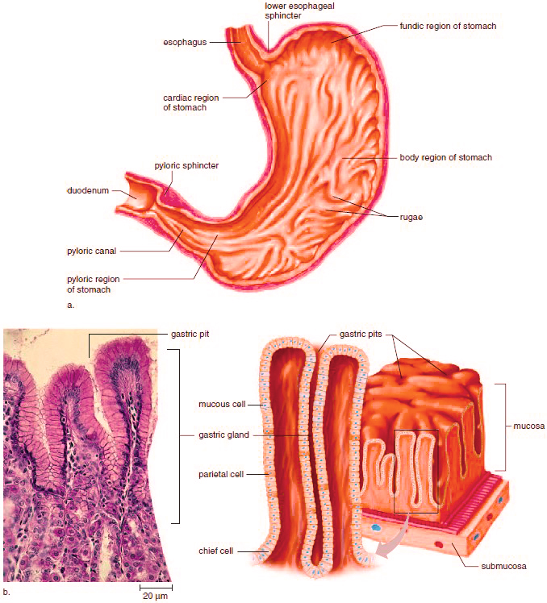

Slide 13
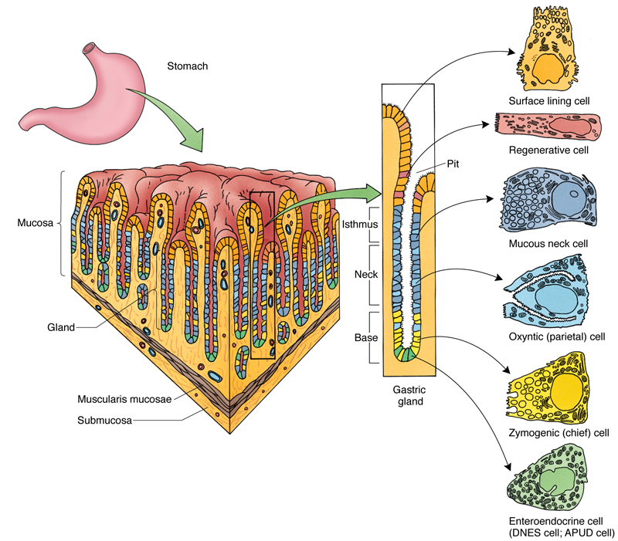
Stomach
The stomach, the most dilated region of the alimentary canal, is a sac-like structure that in the average adult can accommodate approximately 1500 ml of food and gastric juices at maximal distention. The bolus passes through the gastroesophageal junction into the stomach, where it is processed into a viscous fluid known as chyme. Intermittently, the stomach empties small aliquots of its contents through the pyloric valve into the duodenum. The stomach liquefies the food, continuing its digestion via the production of hydrochloric acid and the enzymes pepsin, rennin, and gastric lipase and via production of paracrine hormones.
The lumen of the fundic stomach is lined by a simple columnar epithelium composed of surface-lining cells, which manufacture a thick mucus layer, known as visible mucus. Surface-lining cells continue into the gastric pits, forming their epithelial lining.
Much of the lamina propria is occupied by the 15 million closely packed gastric glands, known as fundic (oxyntic) glands in the fundic region. Each fundic gland extends from the muscularis mucosae to the base of the gastric pit and is lined composed of a simple columnar epithelium consisting of of six cell types: surface lining cells, parietal (oxyntic) cells, regenerative (stem) cells, mucous neck cells, chief (zymogenic) cells, and diffuse neuroendocrine system (DNES) cells.
For more information see General Plan of the Digestive Tract in Chapter 17 of Gartner and Hiatt: Color Textbook of Histology, 3rd ed. Philadelphia, W.B. Saunders, 2007.
Figure 17–3 Cellular composition of the fundic stomach and fundic gland. The fundic glands open into the bottom of the gastric pits, and each gland is subdivided into an isthmus, a neck, and a base.

Slide 14
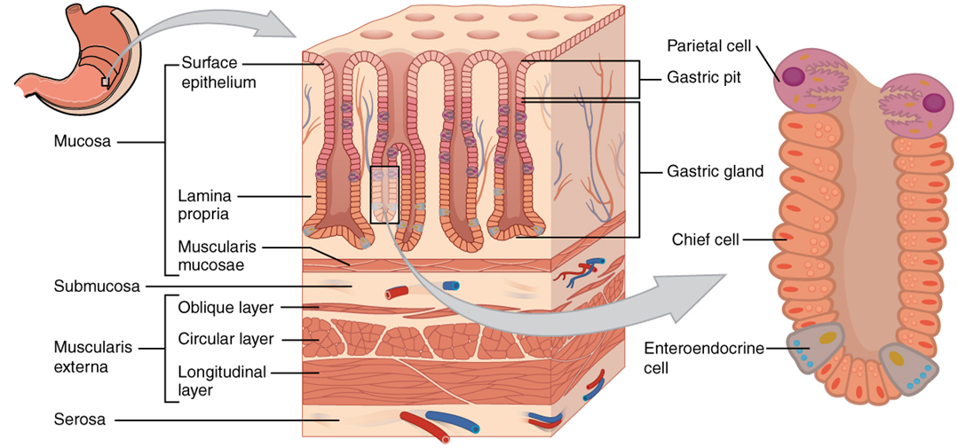

Slide 15
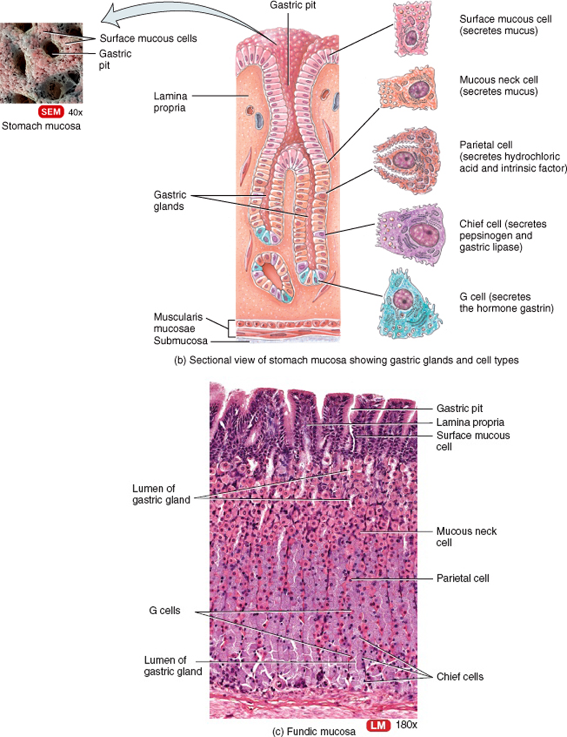

Slide 17
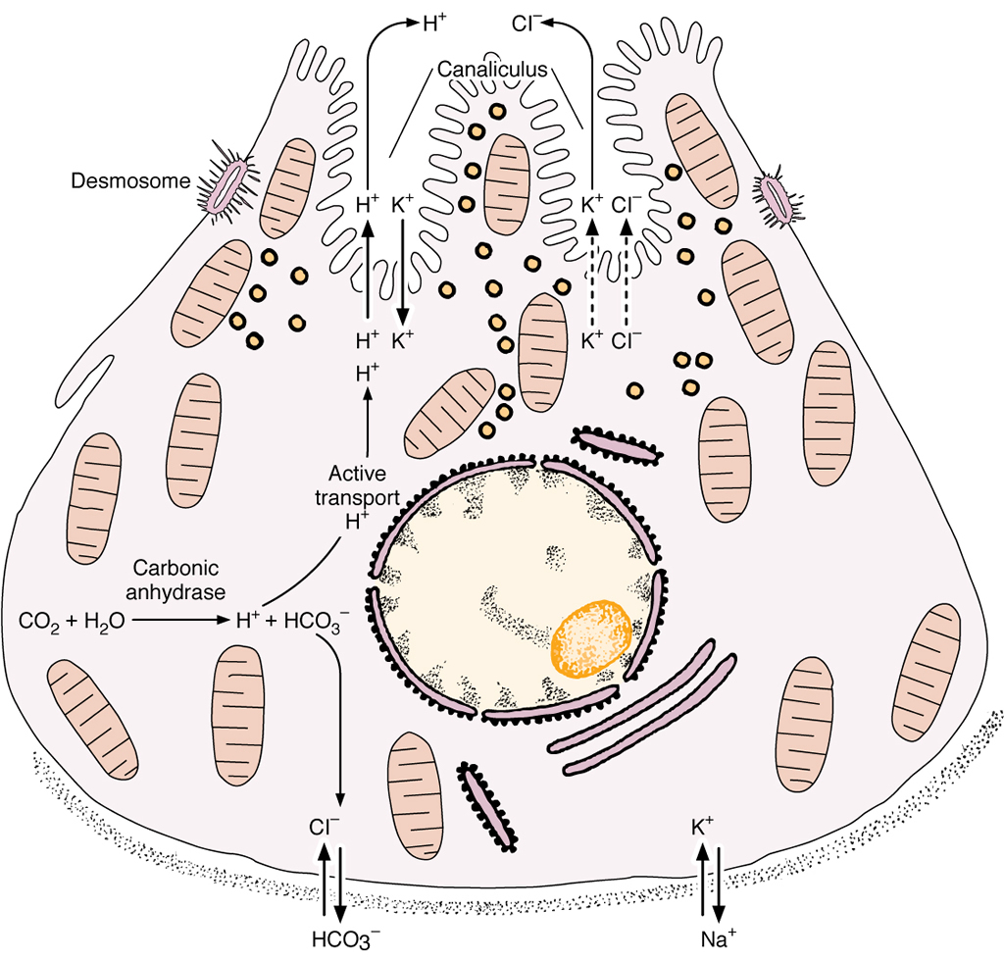

Slide 18
Parietal Cells
Figure 17–12 Parietal cell. A, Well-developed tubulovesicular apparatus in the resting cell. B, Mechanism of hydrochloric acid release. C, Numerous microvilli in the active cell..
Parietal cells have receptors for gastrin, histamine, and acetylcholine. Binding of these signaling molecules causes the cells to make and release HCl into the intracellular canaliculus.
Carbonic anhydrase facilitates the formation of H₂CO₃ (from water and carbon dioxide), which dissociates into H⁺ and HCO₃– within the cytoplasm.
An H⁺, K⁺-ATPase, using ATP, pumps intracellular H⁺ out of the cell into the intracellular canaliculi and transfers extracellular K⁺ into the cell.
Carrier proteins pump K⁺ and Cl– out of the cell. Thus Cl–and H⁺ enter the lumen of the intracellular canaliculus separately to combine into HCl.
K⁺ is actively transported into the cell. The high intracellular K⁺ concentration forces K⁺ to leave the cell via ion channels located in the basal plasmalemma and at the microvilli. Thus, K⁺ is constantly recirculated in and out of the parietal cell.
Water, derived from the extracellular fluid, enters the parietal cell and then leaves the cytoplasm to enter the intracellular canaliculus as a consequence of the osmotic forces generated by the movement of ions just described. Because the intracellular canaliculus is an extension of the lumen of the stomach, the solution of HCl manufactured by the parietal cells enters the gastric lumen.
For more information see Parietal Cells in Chapter 17 of Gartner and Hiatt: Color Textbook of Histology, 3rd ed. Philadelphia, W.B. Saunders, 2007.

Slide 19
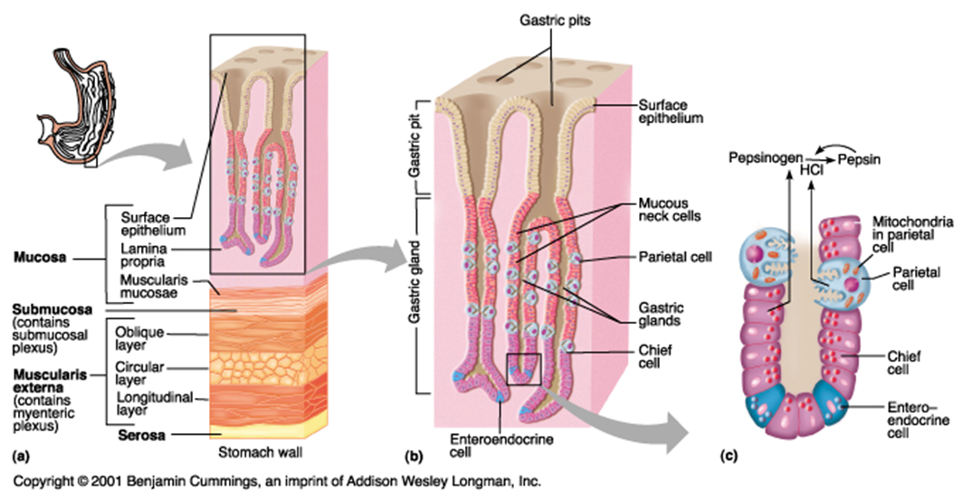

Slide 20
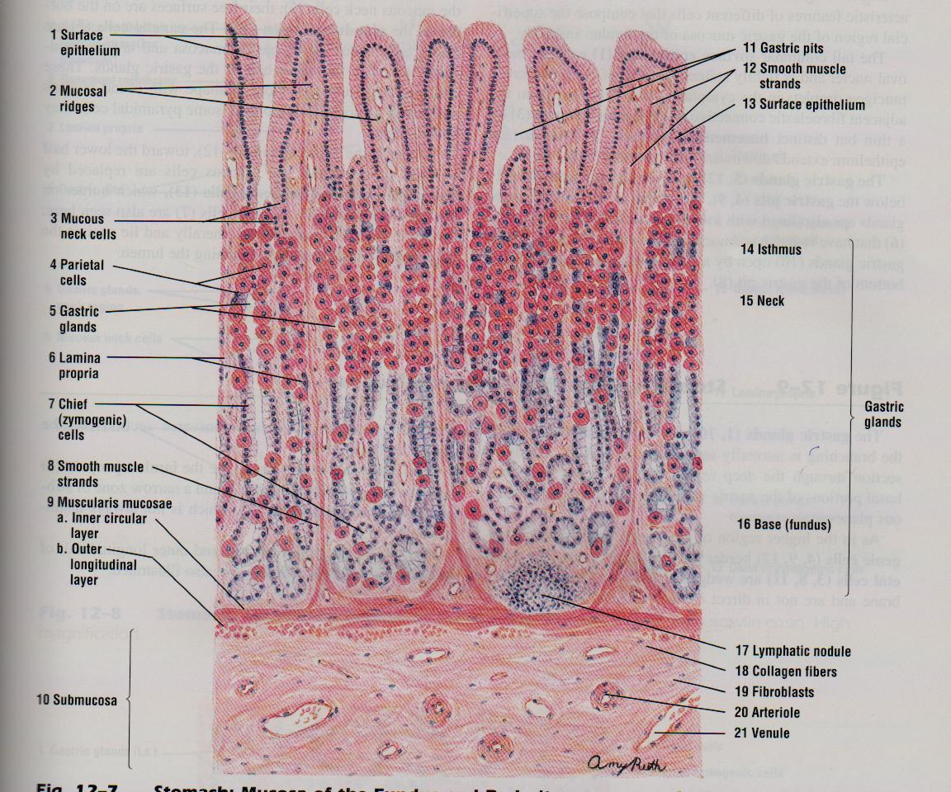

Slide 21
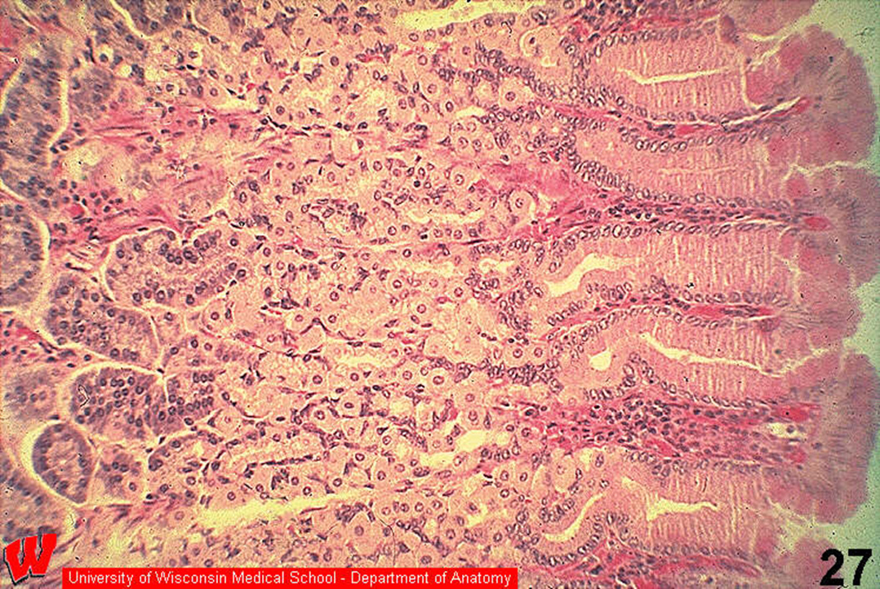

Slide 22
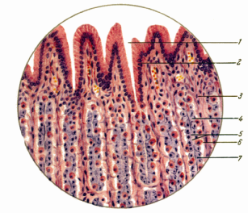

Slide 23
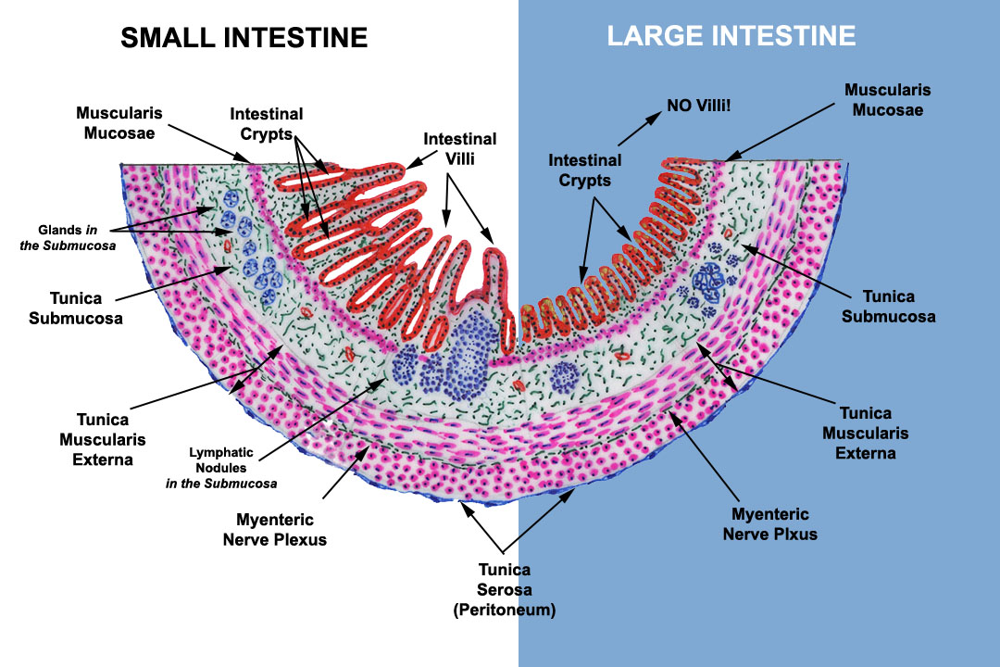
https://www.google.kz/urlweb.northseattle.edulearnBIOLDigestive.htm&bvm

Slide 24
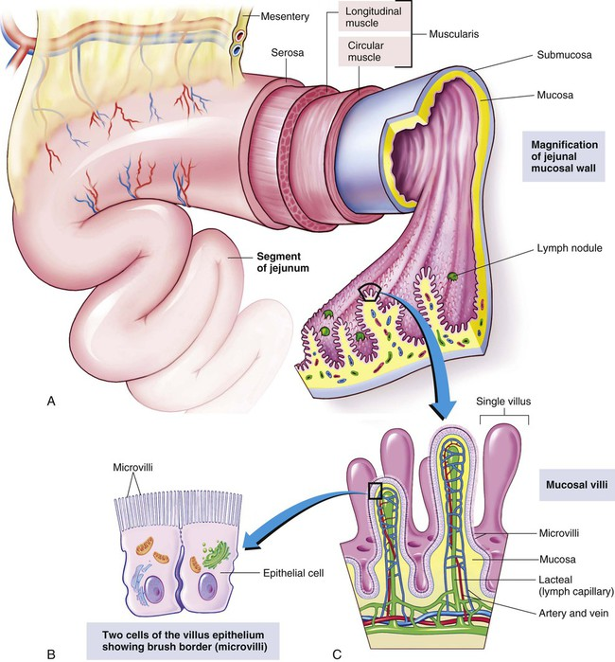

Slide 25
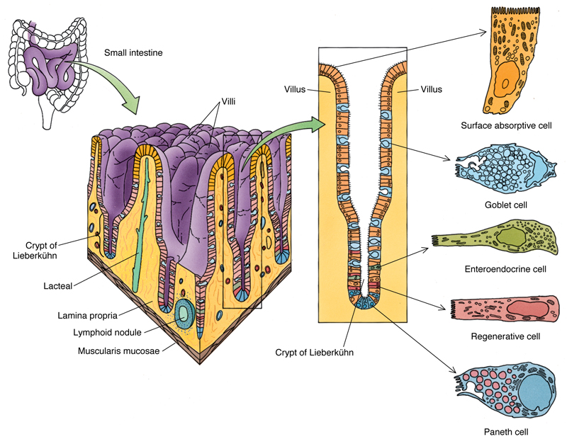
Small Intestine
The small intestine is divided into three regions: duodenum, jejunum, and ileum. Although these regions are similar histologically, their minor differences permit their identification.
The small intestine digests food and absorbs end products of digestion. The duodenum receives enzymes and a buffer from the pancreas and bile from the liver. Epithelial cells and glands of the mucosa (and Brunner’s glands in the submucosa of the duodenum) also contribute buffers and enzymes.
Three types of modifications increase the luminal surface of the small intestine: plicae circulares, villi, and microvilli.
The simple columnar epithelium covering the villi and the surface of the intervillar spaces is composed of surface absorptive, goblet, and DNES cells.
The lamina propria, has many glands, the crypts of Lieberkühn, as well as an abundance of lymphoid cells and blood vessels and a central lacteal.
The crypts of Lieberkühn are composed of DNES, surface absorptive, goblet, regenerative, and Paneth cells.
Regional differences are that the duodenum has Brunner’s glands, the ileum has collections of lymphoid nodules, Peyer’s patches, and the jejunum has neither Brunner’s glands nor Peyer’s patches.
For more information see Small Intestine in Chapter 17 of Gartner and Hiatt: Color Textbook of Histology, 3rd ed. Philadelphia, W.B. Saunders, 2007.
Figure 17–13 Mucosa, villi, crypts of Lieberkühn, and component cells of the small intestine. Note that the crypts of Lieberkühn open into the intervillar spaces. There is a solitary lymphoid nodule in the lamina propria.

Slide 26
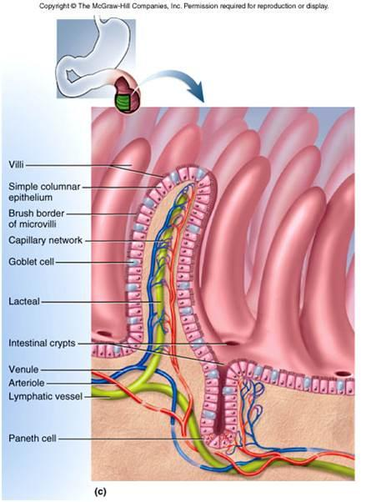
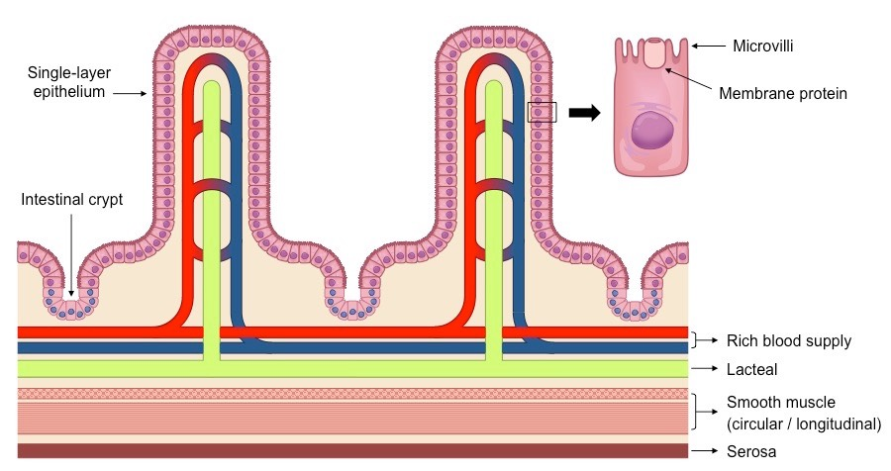
http://ib.bioninja.com.au/standard-level/topic-6-human-physiology/61-digestion-and-absorption/small-intestine.html

Slide 27
http://www.slideshare.net/MichaelWalls1/section-3-chapter-17-liver-and-intestines

Slide 28
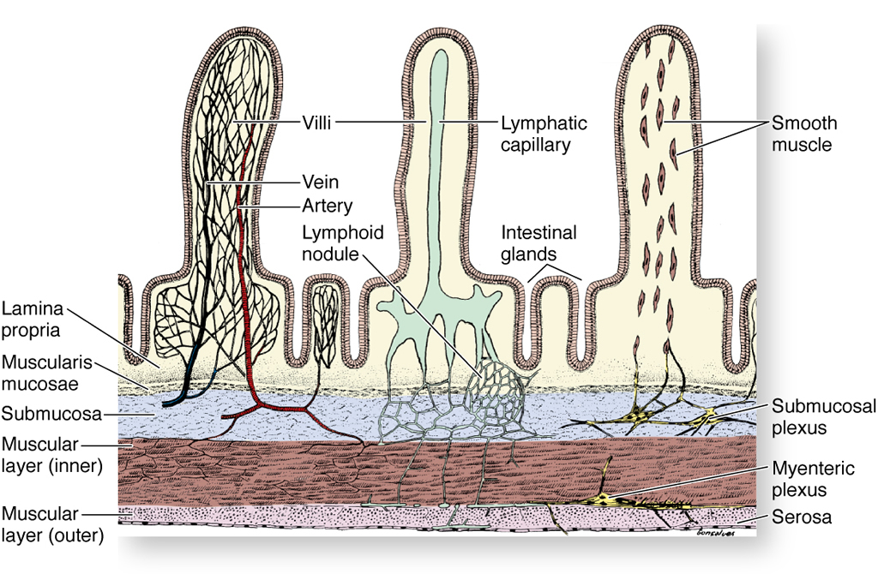

Slide 29
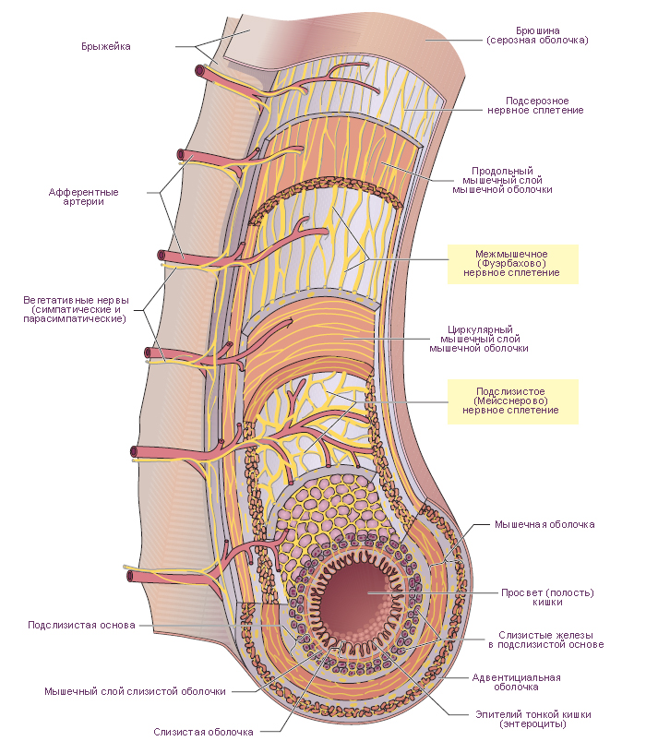

Slide 30
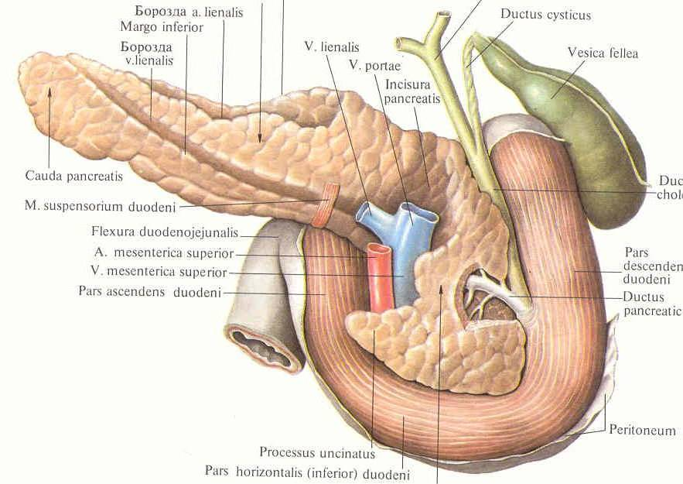

Slide 31
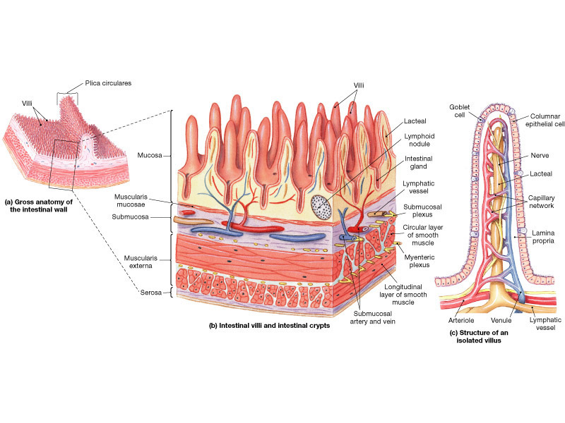

Slide 32
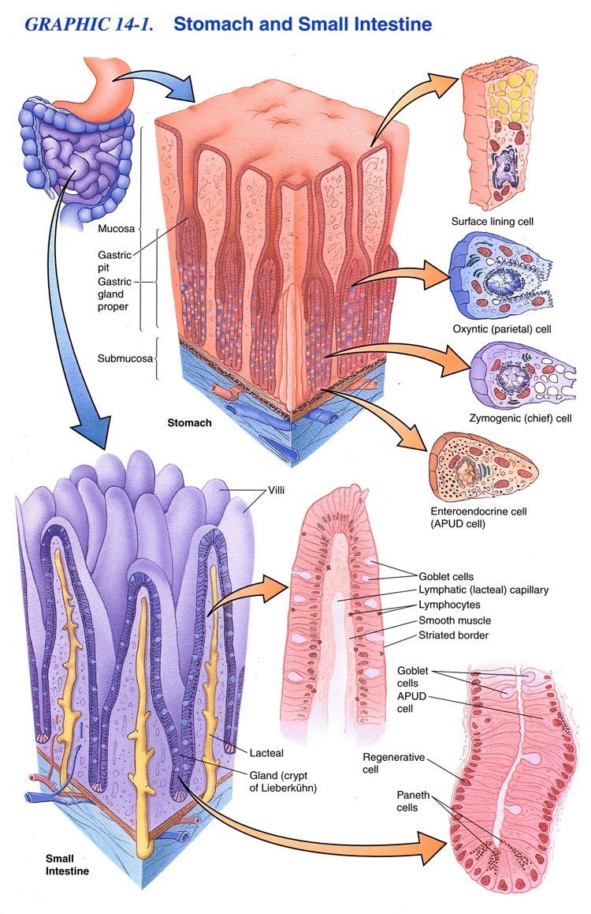

Slide 33
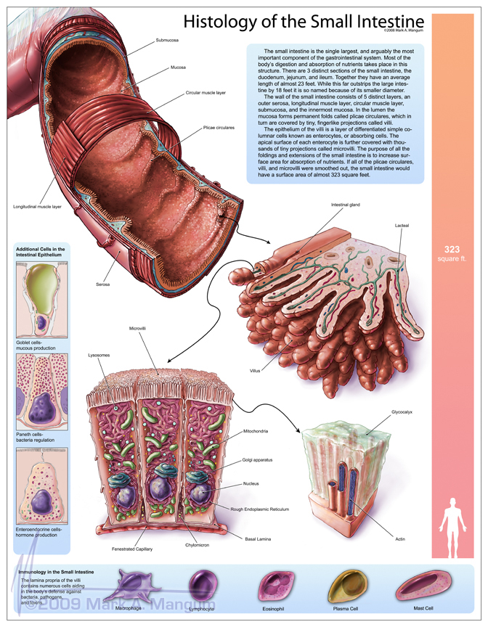

Slide 34
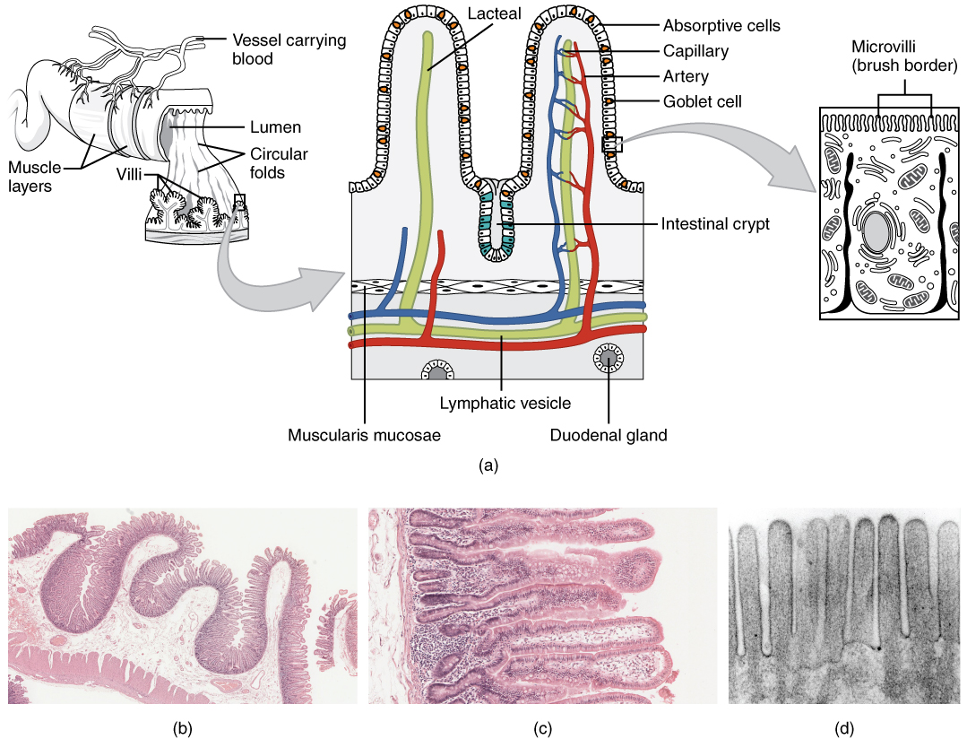

Slide 35
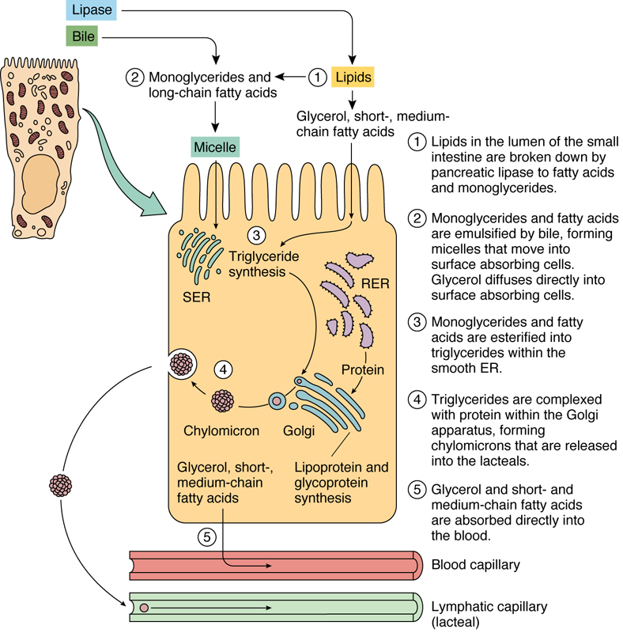
Absorption in the Gut
The process of digestion is intensified in the duodenum by enzymes derived from the exocrine pancreas. The final breakdown of proteins and carbohydrates occurs at the microvilli, where dipeptidases and disaccharidases, adherent to the glycocalyx, liberate individual amino acids and monosaccharides. These monomers are transported into the surface absorptive cells by specific carrier proteins. Lipids are emulsified by bile salts into small fat globules that are split into monoglycerides and fatty acids. Bile salts segregate monoglycerides and free fatty acids into micelles, which diffuse into the surface absorptive cells through their cell membrane.
Water, amino acids, ions, and monosaccharides enter the surface absorptive cells and are released into the intercellular space at the basolateral membrane to enter the capillary bed of the villi to be transported to the liver.
Long-chain fatty acids and monoglycerides enter the SER of the surface absorptive cell, where they are reesterified to triglycerides. In the Golgi these are combined with a β-lipoprotein coat, manufactured on the RER, to form chylomicrons. Chylomicrons released from the Golgi enter into the lacteals in the lamina propria, and are known as chyle. Rhythmic contractions of the smooth muscle cells located in the cores of the villi inject the chyle from the lacteal into the submucosal plexus of lymph vessels.
Short-chain fatty acids (<12 carbons in length) do not enter the SER but progress to the basolateral membrane of the surface absorptive cell, diffuse into the lamina propria, and enter the capillary loops to be delivered to the liver.
For more information see Histophysiology of the Small Intestine in Chapter 17 of Gartner and Hiatt: Color Textbook of Histology, 3rd ed. Philadelphia, W.B. Saunders, 2007.
Figure 17–21 Fat absorption, fat processing, and chylomicron release by surface absorptive cells. SER, smooth endoplasmic reticulum; RER, rough endoplasmic reticulum.

Slide 37
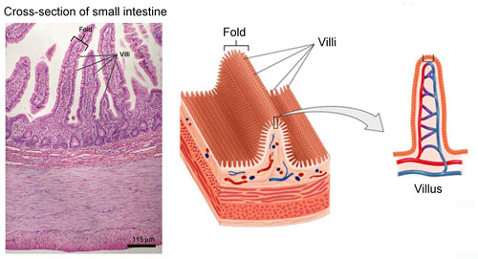

Slide 38
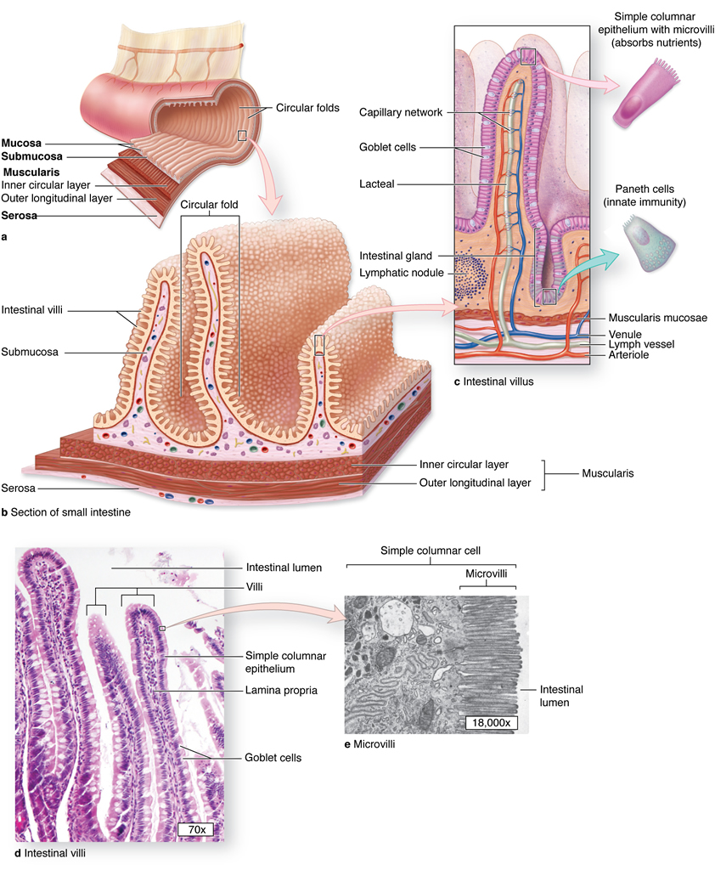

Slide 39
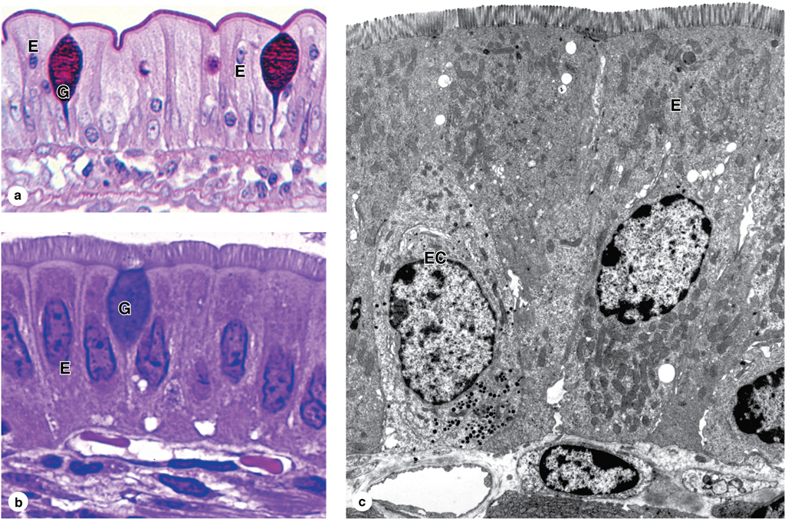

Slide 40
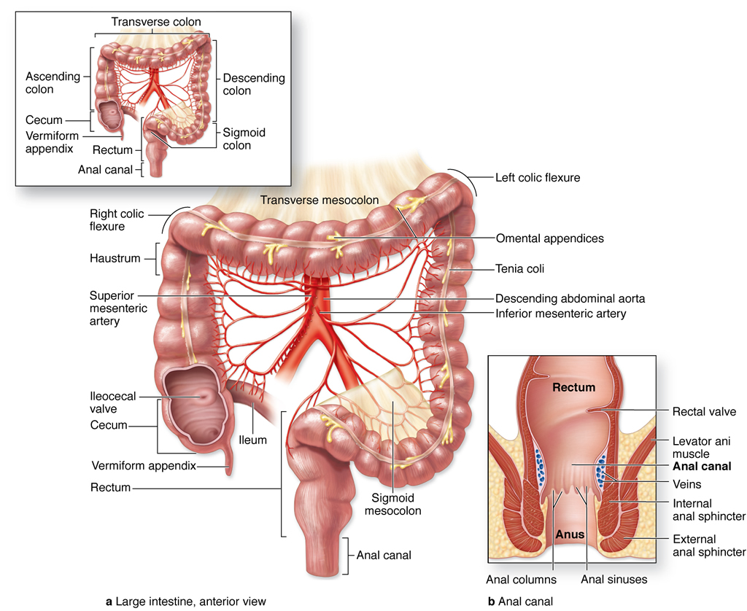

Slide 41
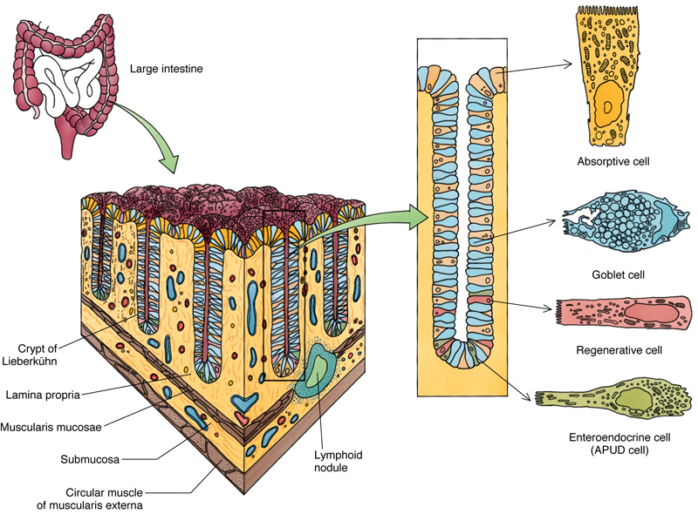
Large Intestine
The large intestine, composed of the cecum, colon (ascending, transverse, descending, and sigmoid), rectum, and anus, absorbs most of the water and ions from the chyme it receives from the small intestine and compacts the chyme into feces for elimination.
The large intestine has no villi but is richly endowed with crypts of Lieberkühn that are similar in composition to those of the small intestine, except for the absence of Paneth cells. The number of goblet cells increases from the cecum to the sigmoid colon, but the surface absorptive cells are the most numerous cell type. DNES cells are also present, although they are few in number.
The lamina propria, muscularis mucosae, and submucosa of the colon resemble those of the small intestine. The muscularis externa is unusual, in that the outer longitudinal layer is not continuous along the surface but is gathered into three narrow ribbons of muscle fascicles, known as taeniae coli. The constant tonus maintained by the taeniae coli puckers the large intestine into sacculations, called haustra coli. The serosa displays numerous fat-filled pouches, called appendices epiploicae.
The large intestine also secretes mucus and HCO₃–. Mucus protects the mucosa of the colon and facilitates the compaction of feces, by facilitating adherence of the solid wastes into a compact mass.
For more information see Large Intestine in Chapter 17 of Gartner and Hiatt: Color Textbook of Histology, 3rd ed. Philadelphia, W.B. Saunders, 2007.
Figure 17–22 Colon, crypts of Lieberkühn, and associated cells.

Slide 42
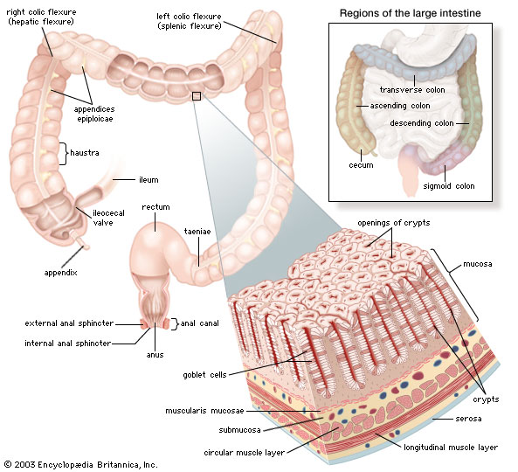

Slide 43
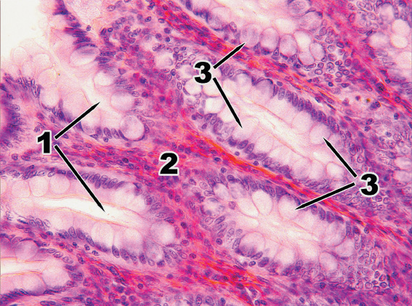

Slide 44
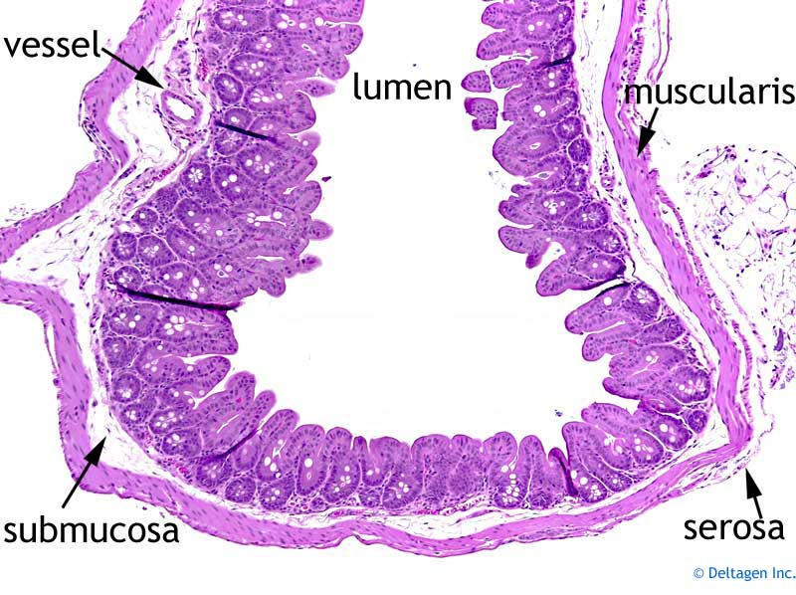

Slide 45
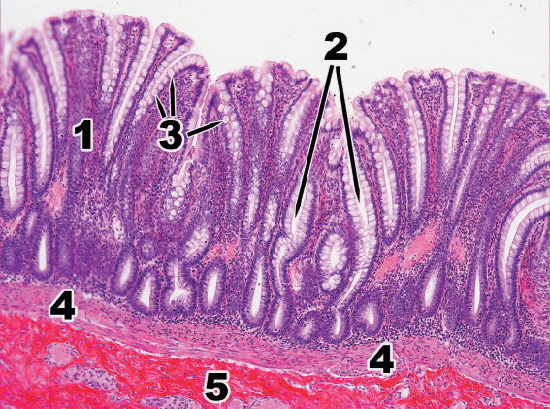

Slide 46
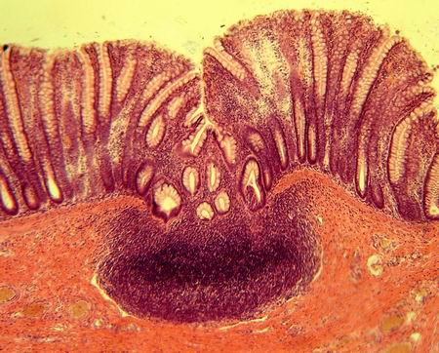
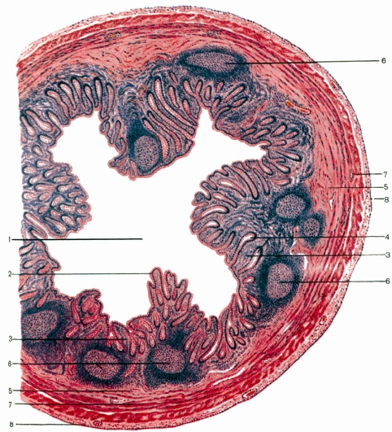
LYMPHOID FOLLICLES OF THE DIGESTIVE TRACT

Slide 47
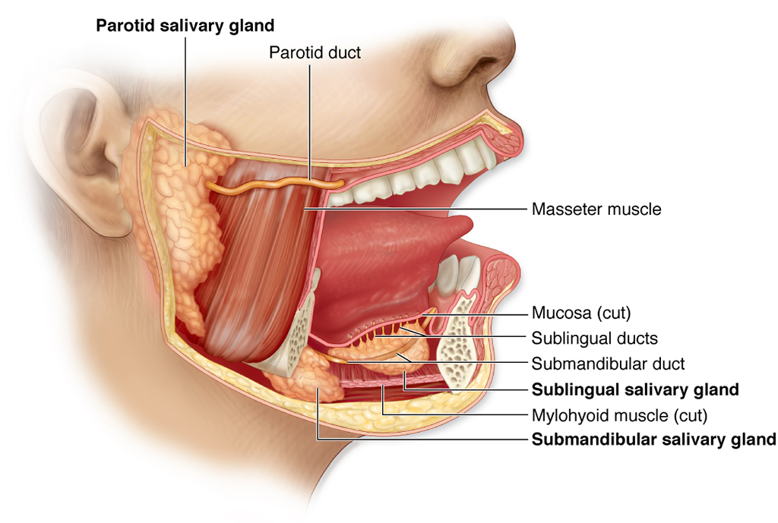

Slide 48
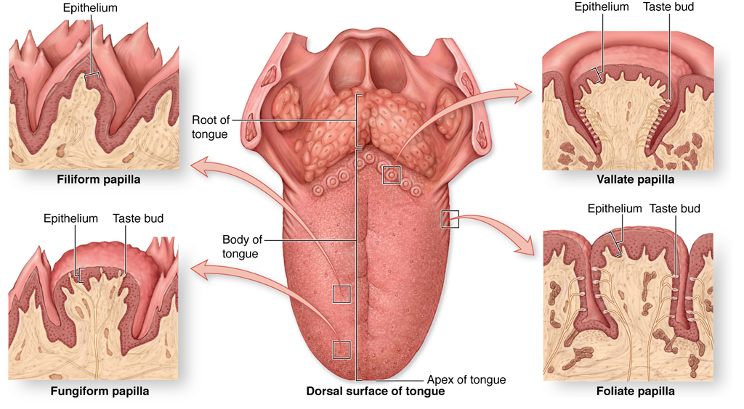

Slide 49
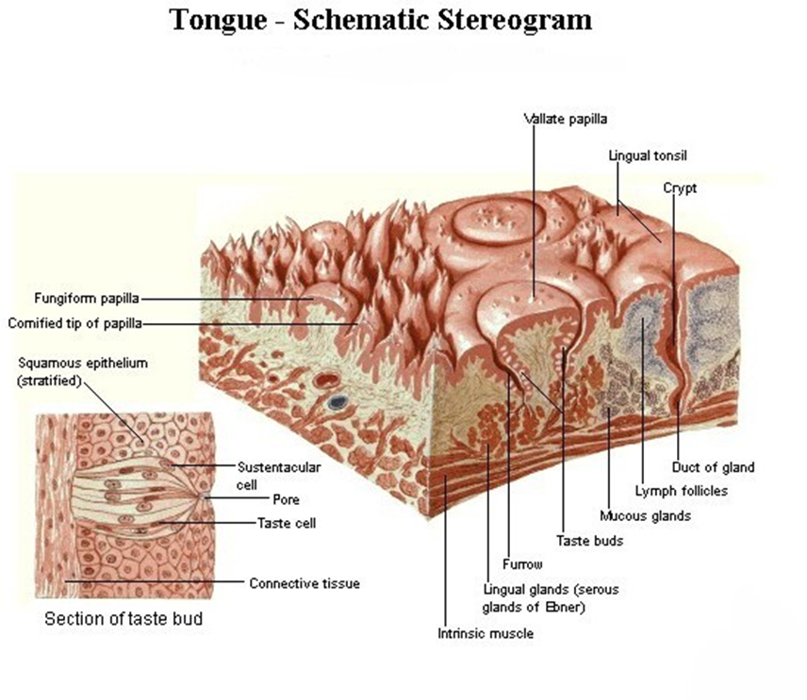

Slide 50
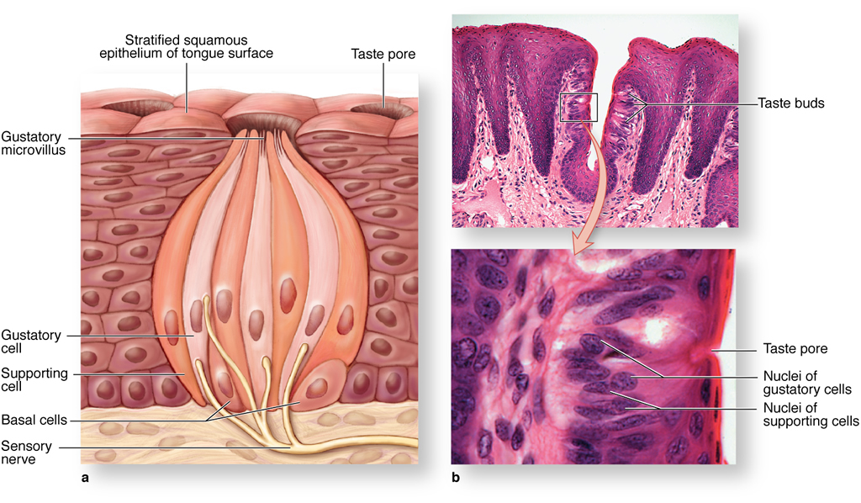

Slide 52
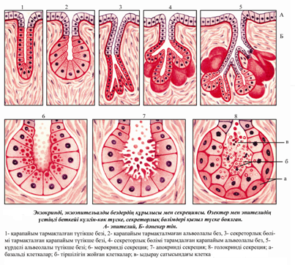

Slide 53
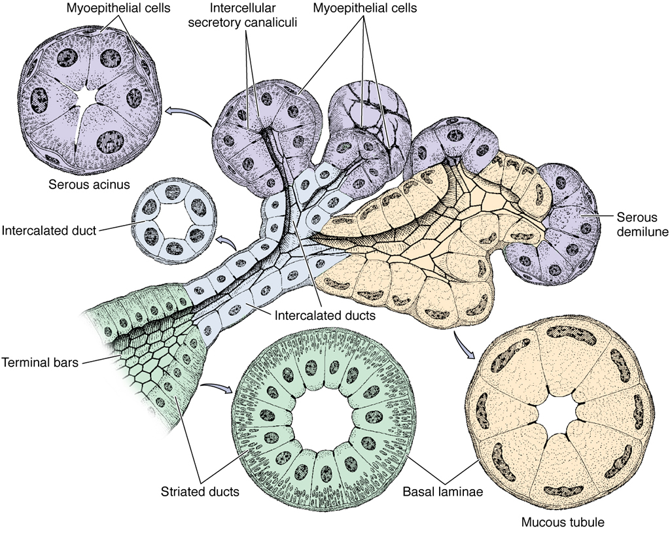

Slide 54
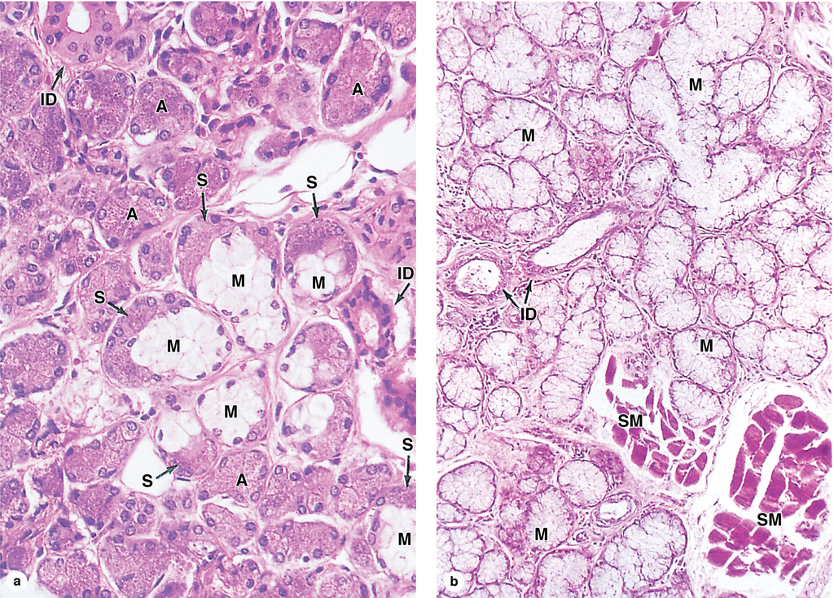

Slide 55
Liver
The liver, similar to the pancreas, has both endocrine and exocrine functions, although, the same cell, the hepatocyte, is responsible for the formation of its exocrine secretion, bile, and its endocrine products. Hepatocytes also detoxify toxins and excrete them in bile.
The liver’s connective tissue capsule, Glisson’s capsule, is loosely attached except at the porta hepatis, where it enters the liver, forming a conduit for the blood and lymph vessels and bile ducts. The liver is unusual, in that its connective tissue elements are sparse; thus, the bulk of the liver is composed of uniform parenchymal cells, the hepatocytes.
The liver has a dual blood supply, receiving oxygenated blood from the hepatic arteries (25%) and nutrient-rich blood via the portal vein (75%). Both vessels enter the liver at the porta hepatis. Blood leaves the liver at the posterior aspect of the organ through the hepatic veins. Bile leaves the liver at the porta hepatis, by way of the hepatic ducts, to be delivered to the gallbladder for concentration and storage.
Hepatocytes form hexagon-shaped classical lobules whose boundaries in human liver can only be approximated.
The region where three classical lobules join each other, is known as a portal area which houses slender branches of the hepatic artery, tributaries of the relatively large portal vein, interlobular bile ducts, and lymph vessels.
Each lobule has a single central vein which receives blood from every sinusoid of that lobule. As the central vein leaves the lobule, it terminates in the sublobular vein which eventually drains into the hepatic vein.
For more information see the Liver section in Chapter 18 of Gartner and Hiatt: Color Textbook of Histology, 3rd ed. Philadelphia, W.B. Saunders, 2007.
Figure 18–9 Liver. A, Gross anatomy of the liver. B, Liver lobules displaying the portal areas and the central vein. C, Portion of the liver lobule displaying the portal area, liver plates, sinusoids, and bile canaliculi.

